Slide 1

Microcomputer Buses
Introduction
Single Board Solutions
System Bus Interconnect
  Network Buses
  Backplane Buses
  SoC Buses
©Paul Davies. Not to be copied, used, or revised without explicit written permission from the copyright owner.
This lecture may contain animations and is best viewed as a slide show

Slide 2
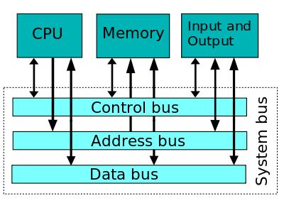
Introduction – Microcomputer Buses
We are all familiar by now with the concept of a bus.
All popular microprocessors (Motorola, Intel, ARM etc), interface to other components in the system (e.g. memory, IO) via a System Bus comprising of :-
  An Address Bus: A collection of address lines used to individually select or identify one memory location or Peripheral register from another during a bus cycle.
  A Data Bus: A collection of signals used to transfer data between CPU and responding memory or peripheral
  A Control Bus: Comprising miscellaneous signals such as, in the case of the 68000 CPU
    Reset*, Clock, R/W*, AS*, LDS*/UDS*, DTACK*, BERR*.
    Interrupt and DMA request signaling e.g. IPL0-2, BR*, BG*, BGACK* etc.
There exists for each CPU a published specification for the system buses which includes an electrical specification, a set of timing diagrams and a well defined protocol to ensure that designers can select potential devices and integrate them into the system to work successfully (or not !!!) with the host CPU. (i.e. synchronous vs. asynchronous transfers, access times, data widths, address range, voltage levels etc.)

Slide 3
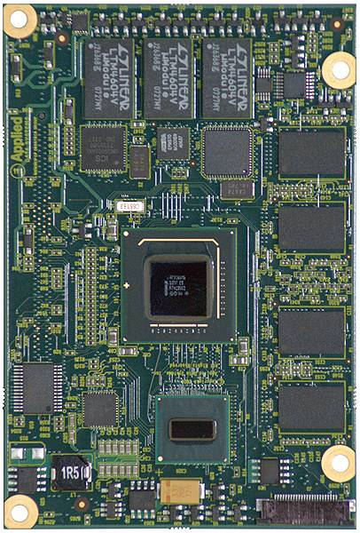
Introduction – Microcomputer Buses
Single Board Solutions
When a computer system is constructed from a single, stand-alone circuit board, e.g. Cell phone, iPod, Satnav device etc. there is little need for the system bus to exist outside the PCB.
Connections between the various components of the system can be made “point to point” using copper tracks, with only those CPU bus signals actually needed by the IO device or memory itself, being connected to it.
For example a memory device would not be interested in the Interrupt or Bus request/DMA signals of the system bus and would not need connecting to them.
In essence single board computers provide an optimum solution to circuit board and system level design, with each one being custom designed to fit one particular application.
This is fine if you are designing a dedicated product for a specific purpose with high volume production in mind.

Slide 4
Introduction – Microcomputer Buses
What are the drawbacks of designing Single Board Computer solutions?
Inflexible – Each new application (unless it is simply a change of software) may require either a complete re-design of the board or extensive modifications to the pcb layout to accommodate new features.
Slow Development Time – Serious software development invariably has to wait for working hardware to be built and debugged.
Cost – Unless we are talking about the need to build 1000+ units, the costs associated with the development for low volume dedicated microcomputer hardware can be prohibitive.
Cont…

Slide 5
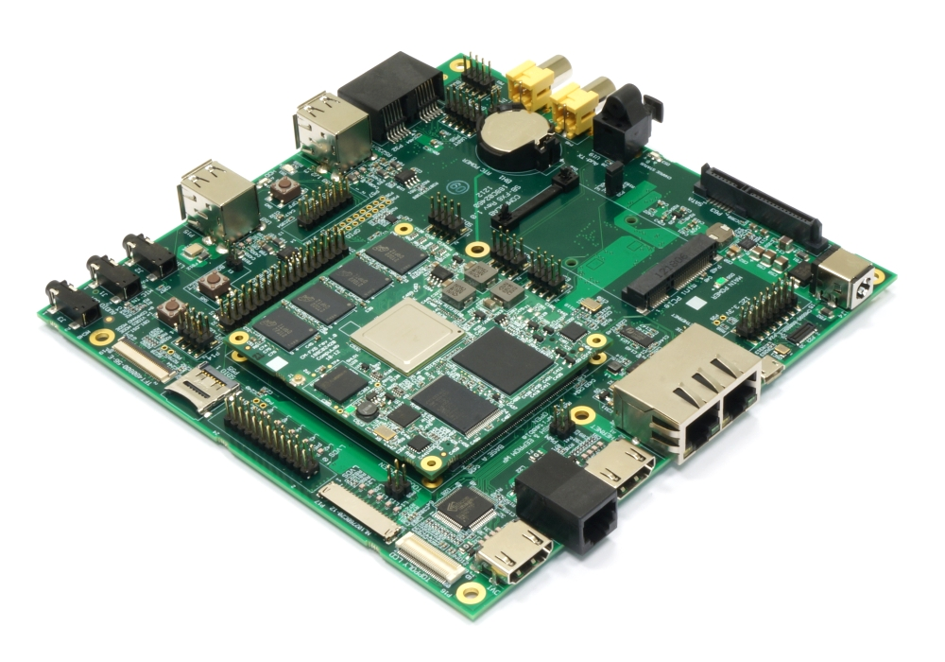
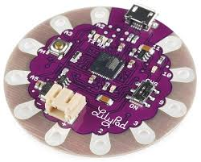
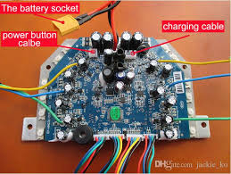
Introduction – Microcomputer Buses
Cont…
Packaging – What’s on the board usually dictates its size – the more hardware it has, the bigger its size and the less reusable it is across different applications.
Large or irregular (non-standardised) shaped PCBs can be a problem.

Slide 6
Introduction – Microcomputer Buses
Modular Computing
In today's fast paced world, and for projects where perhaps just one off designs are needed, what we actually want is a more modular approach to computer construction where functionality is partitioned onto separate boards and modules.
This would allow the system designer to easily, quickly and cost effectively configure computing solutions from a range of “plug in” boards.
External System Buses and Connectors
When a computer system is modularised into a number of separate boards, it becomes necessary to extend the CPU system buses onto some kind of “off board” connector so that modules in the system can be electrically connected together.

Slide 7
Introduction – Microcomputer Buses
Types of System Bus Interconnect
Today's computer systems are often composed of a large number and type of interconnected buses to allow various computers and peripherals to communicate at their optimum speed and efficiency.
Broadly speaking standardised microcomputer buses fall into one of the following three categories.
  Network Buses
  Backplane Buses
  SoC Buses

Slide 8
Network Buses
Network buses are generally characterised as
  Serial Interconnect (2 or 3 wire communications)
  High on Protocol
  Software Intensive (usually require libraries or drivers to handle protocol)
  Designed for distributed hardware applications
Network connections are typically made using
  Copper tracks on a PCB,
  "Twisted Pair” wire or
  Fiber Optic cables.
Network buses support multiple nodes, often using some kind of device addressing or broadcast ability and free the designer of the constraints of working within one box.

Slide 9
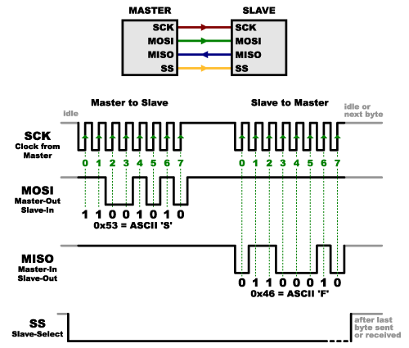
Example Network Buses include:
  Ethernet (distributed CPUs & computers)
  USB (distributed peripherals, disks, cameras, printers etc.)
  FireWire (as per USB)
  Serial ATA (disks)
  PCI-Express, Infiniband, RapidIO, Star Fabric, (distributed multi-processing)
  CanBus, I²C, SPi (distributed IO and chip interconnect on PCBs).
  Bluetooth (wireless serial interconnect bus),
  RS 232/422 etc.
Example 3 wire (plus slave select) SPI Serial Bus

Slide 10
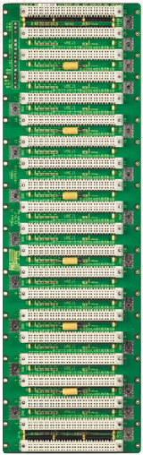
Backplane Buses: Origins, Developments and Standards
A backplane bus is nothing more than a collection of electrical signals (typically the host CPU’s address, data and control buses) made available ‘off board’.
Example backplane bus standards include: VME, MultiBus I & II, S100, STD/STE, G64/G96, ISA, PCi, PC-104, AGP etc (some obsolete, some current).
Signals propagate between boards via a backplane to connect together a variety of “plug-in” modules and distribute power to them.
Connections to the backplane are usually made via some form of edge connector plug and socket arrangement like this one for VME bus with 21 slots.
VME bus offers parallel multi-processing through its support for multiple CPU modules plugged into the backplane and centralized bus arbitration.
21 slot VME backplane

Slide 11
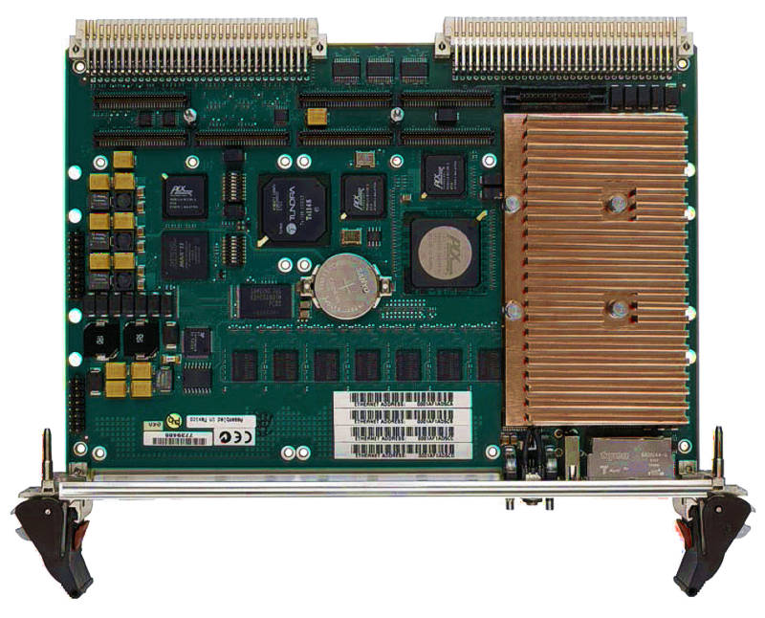
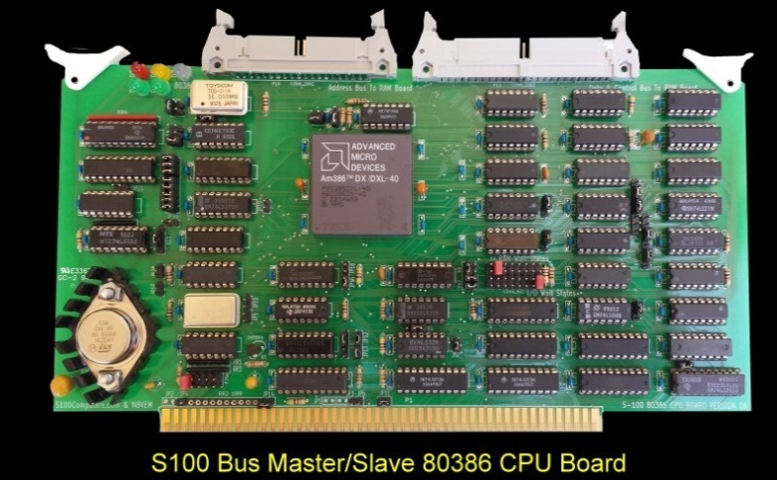
Backplane Buses: Origins, Developments and Standards
A backplane standard refers to the fact that there exists a published specification describing
  Electrical,
  Mechanical and
  Protocol/Timings
required for conformance with other products designed for use on that bus.
In the late 70’s to mid 80’s, bus standards evolved in an ad hoc, almost chaotic manner. Interested parties often designed their own buses or extended existing buses which compromised compatibility.
User groups and small system designers were often bullied by the “Big Boys” of industry (Intel/Motorola etc.) until their needs were met.
An example of this effect was the S100 (IEEE-P696) bus which started life as a “hobbyist” bus inside the 1st generation of home computers, the Altair 8800 based originally on the 8 bit Intel 8080 processor.
VME bus processor board (IEEE – P1014)
S100 bus: Earliest commercial microcomputer backplane bus standard (IEEE – P696)

Slide 12
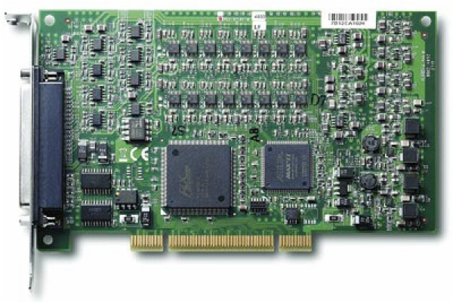
De-Facto and Standardised Backplane Buses
Some backplane standards have emerged by accident, due in part to the sheer weight of numbers and popularity of products available for the bus.
These products often started out as proprietary designs to meet the needs of one project.
However due to their popularity, they evolved into a “de-facto” standards because they lacked any kind of international standards recognition.
A good example of this are the ISA and PCi buses, which were intended for use inside one product, the IBM PC.
Most modern and emerging bus standards could not survive today without some kind of standardisation.
A/D and D/A controller on a PCI bus card. Note weird shape and poor quality gold plated connector.

Slide 13
Backplane Buses: Origins, Developments and Standards
Most current and proposed buses tend to be based on an Open Systems Architecture (OSA), meaning that no one individual or company owns the standard.
Most are managed by an International Standards Organisation such as the IEEE or ANSI who set up Internal Standards Groups e.g. VITA in the case of VME bus and PCI-SIG (Special Interest Group) in the case of PCi bus.
Original Equipment Manufacturers
Suggestions
International Standards Organisation: IEEE/ANSI
Proposals, Standards etc
Suggestions
The User Community
IC Manufacturers
Internal Standards Group
Independent User/Interest Groups
Suggestions

Slide 14
Backplane Buses: Factors Affecting Choice
What should you consider when buying into a backplane standard?
  Compatibility – Is there an international published standard to ensure one manufacturer’s products work with another? Can you design your application specific hardware to be compatible with that standard?
  Availability – How many independent vendors support the standard? Can products be second sourced from 2 or more manufacturers? Is there a wide range of different products available in the areas you need? e.g. specialised I/O, signal/video processing etc.
  Long Life - The bus standard must support both existing & future demands and must not become obsolete within the near future
  (S100, ISA or PCi bus anybody?)
  Evolution – Is the bus standard static (in which case it might have a short life) or is it evolving (which is good, provided backward compatibility is maintained).
  Licensing – You shouldn’t have to pay expensive licensing fees to use the standard, which should be in the public domain, i.e. freely available with no copyright or royalty payments.

Slide 15
Backplane Buses: Factors Affecting Choice
  Suitability – for the product and customer. For example if you are designing a PC based system, then the use of PCi-Express bus may be mandatory. For military, manufacturing, instrumentation and control you may be constrained to use VME. For telecoms, Compact PCI bus may be mandatory.
  Cost and Complexity – You don’t want to pay for features you don’t need. For example buying into a 64 bit multi-processor bus standard to support your 8 bit microcontroller application doesn’t make much sense as the resulting plug-in board/backplane will be large, complex and expensive.
  Software Support – Make sure that Operating System and Device Drivers exist for the CPU and I/O boards. Don’t base your choice of a bus standard just upon the availability of the latest CPU architecture on that bus. Maturity is much more important than the latest processor chip from Intel or Motorola.
  Packaging – Will it fit inside your product? You can’t put VME bus inside a cell phone - it needs a 19inch rack. PC-104 bus is a very compact PC solution suitable for small robots and other instrumentation and control applications.
  Performance – data throughput, interrupt latency, support to multiple CPUs etc.

Slide 16
Typical Assortment of Network and Backplane Buses
Network Bus: Ethernet, PCi - Express,
Infiniband, RapidIO, Starfabric
Backplane Bus: e.g. VME bus
Distributed System 1
Processor Card
Local System Bus: 68k, PowerPC, x86, ARM
Plug in Modules
Graphics Module
Distributed System 2
Network Bridge
IO
Ram
Rom
CPU
IO
IO Module
Distributed System 3
Network Bus: USB/FireWire
USB
FireWire
Plug in Module: Intelligent IO/Peripheral Card
Serial ATA Controller
Local System Bus: 8/16/32 bit CPU based
Disks
SATA
Network Bus: CanBus
Memory
Module
Network
IO
Ram
Rom
uC
CPU
Module 2
Slave 1
Slave 2
Slave 3
IC₃
Analog
IO
Parallel
IO
IC₁
IC₄
CPU
Module 3
IC₂
IO
IO
IO
Network Bus: I²C, SPI

Slide 17
Flexible FPGA/ASIC Interconnect Buses
(SoC Buses)

Slide 18
SoC (System on Chip) buses
Because of the flexibility afforded by FPGA and ASIC design, i.e. devices not restricted to an edge connector or by the number of signals/wires in a system, a number of standardized interconnect buses have emerged from various manufacturers. Some of these are listed below:-
  Advanced Microcontroller Bus Architecture (AMBA) from ARM Ltd.
  Defines a number of sub-buses: e.g. Advanced High performance Bus (AHB), Advanced eXtensible Interface (AXI) bus and the simpler Advanced Peripheral Bus (APB).
  Avalon from Altera now part of Intel
  CoreConnect from IBM
  WishBone from OpenCores.org
Features include support for multiple processors/cores e.g. arbitration etc.
Advanced high speed data transfers (up to 1024 bit data buses).
Burst, pipelined, streaming and split transaction protocols (see later lecture).
Multiple system buses for distributed and local memory and IO per core.
Use of Advanced tools to facilitate system design and integration.
Plug-and-play compatibility (hopefully).

Slide 19
Altera Avalon Bus
Altera proprietary bus specification intended to support Nios II 32 bit soft core processor.
Avalon Provides
  Address Decoding
  Separate Data buses for read/write (eliminates need for tri-state outputs)
  Programmable Wait-State Insertion
  Arbitration for Multi-Master Systems
Transfer Types
  Simple 32 bit read/write transfers
  Pipelined Transfers
  Burst transfers
  Streaming
Nios Processor
Switch PIO
32-Bit
Nios
Processor
Address (32)
Read
Avalon Bus
Write
LED PIO
Data In (32)
Data Out (32)
7-Segment
LED PIO
IRQ
IRQ #(6)
PIO-32
ROM
(with Monitor)
UART
Timer
User-Defined Interface

Slide 20
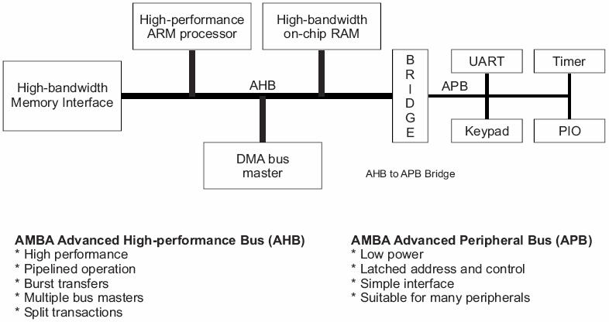
Typical AMBA AHB-based system from ARM

Slide 21
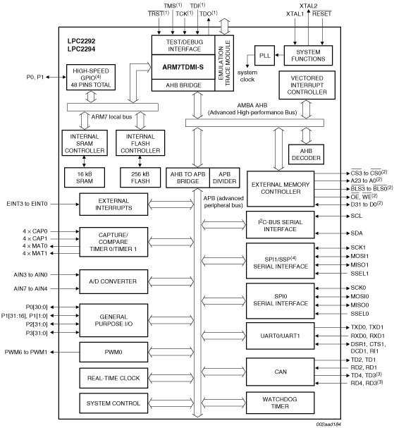
AHB and APB buses used inside an LPC2294 ARM microcontroller

Slide 22
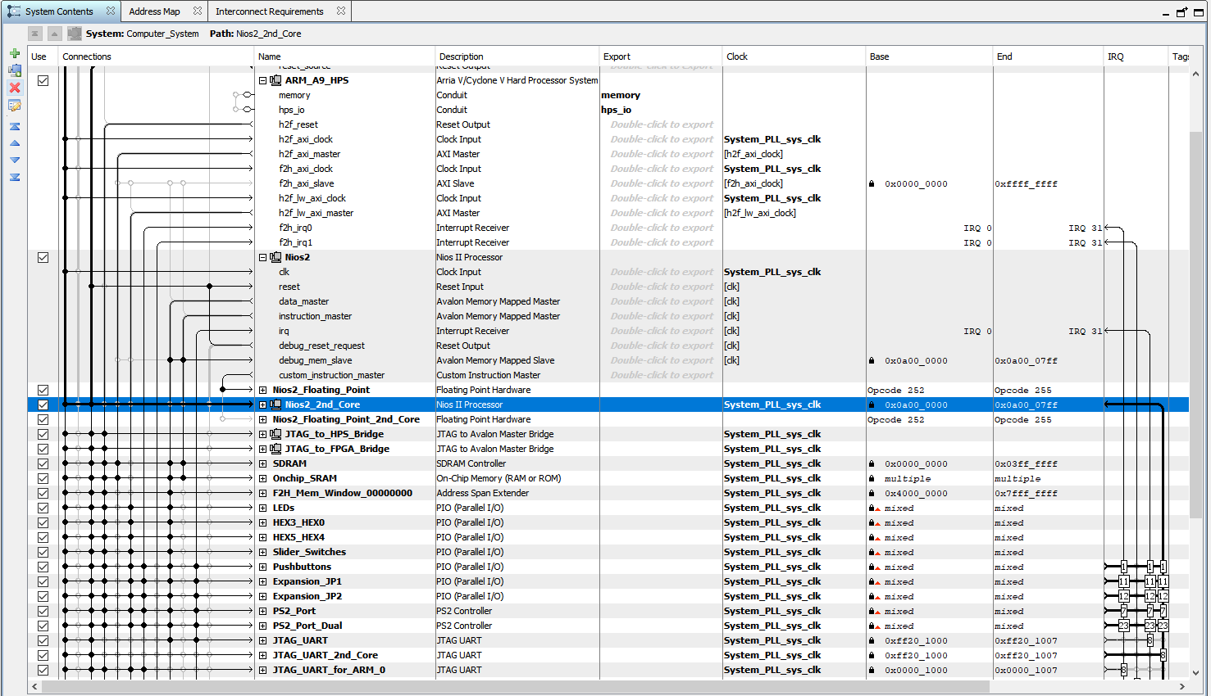
Example Dual core ARM A9 and Dual NIOS II processor based systems designed with Qsys tools in Quartus V15.0. Drag and Drop component placement and connect.
Automatic creation and connection of multiple CPU buses. Automatic inclusion of Arbitrators and bus MUX logic. Automatic/Manual Address map creation and Interrupt (IRQ) assignment

Slide 23
Traditional Multiple Masters using Shared Bus
SoC buses can help overcome the bottlenecks of traditional backplane buses (shown below) where Multiple CPUs had to compete for access to fully global resources through a shared system backplane bus (a.k.a. bottleneck).
Masters
System CPU
(Master 1)
System CPU
(Master 2)
Bottleneck
Arbiter Determines Which Master has Sole Access to Shared Bus
Bus Arbiter
DMA Arbitor
Shared System Backplane Bus
Program
Memory
I/O
1
I/O
2
Data
Memory
Slaves

Slide 24
Flexible Distributed Resources with Arbitration
The flexibility of FPGA interconnect allows multiple local and shared buses to be created within the Chip allowing resources to be distributed, increasing bandwidth and performance and avoiding traditional bottlenecks.
Local buses reduce reliance on arbiters
Master 1
(System CPU)
Master 2
(System CPU)
Masters
Local Bus
Local Bus
Arbiter
I/O
1
I/O
2
I/O
3
I/O
4
Slaves
Program
Memory
Shared
Memory
Program
Memory

